Slide 1
Mastering Azure networking concepts – ExpressRoute and Azure Firewall
Jon Ormond, Principal PM
Azure Networking

Slide 2
Session learning objectives
Business Problem:
Contoso wants to host a web site in Azure but is concerned about security.
At the end of this session, you should be better able to…
discuss Azure Networking options in general
describe how virtual networks can be used, including VNet Peering
describe connectivity options from on-premises to Azure
know how to implement and configure Azure Firewall
understand and describe the three rule types associated with Azure Firewall
understand how to monitor and track events on the Azure Firewall

Slide 3
Azure PowerShell SDK Update

Slide 4
Azure PowerShell SDK - Az
Azure PowerShell SDK Module - Az
Not compatible with the older AzureRM SDK (ie can’t be installed side by side)
There is an alias set so AzureRM commands will still work
It’s not required now, but new features are going into Az only
New Azure Login Method
Connect-AzAccount
AzureRM commands should work with Enable-AzureRmAlias
https://azure.microsoft.com/blog/how-to-migrate-from-azurerm-to-az-in-azure-powershell/

Slide 5
Idempotent PowerShell Operations
# 3.3 Create Public IPs
Write-Host (Get-Date)' - ' -NoNewline
Write-Host “Creating Public IP address“ -ForegroundColor Cyan
Try {$pip = Get-AzPublicIpAddress -ResourceGroupName $ResourceGroup `
-Name $VMNameASH'-pip' -ErrorAction Stop
Write-Host "resource exists, skipping“
}
Catch {$pip = New-AzPublicIpAddress -ResourceGroupName $ResourceGroup `
-Location $EastRegion `
-AllocationMethod Dynamic `
-Name $VMNameASH'-pip’
}
Notes:
Take Aways:
Variables in PowerShell always start with $
The top two write-host commands shown here are how I track where I am in the script, helps to see the time between commands sometimes.
The Try/Catch logic ensures the resource is only created once, note the ErrorAction which is required to ensure the Catch statement actually catches the error
The tick (`) at the end of some lines just tells PowerShell to ignore the carriage return and treat the next line as one big continuous line.

Slide 6
Microsoft Global Footprint

Slide 7
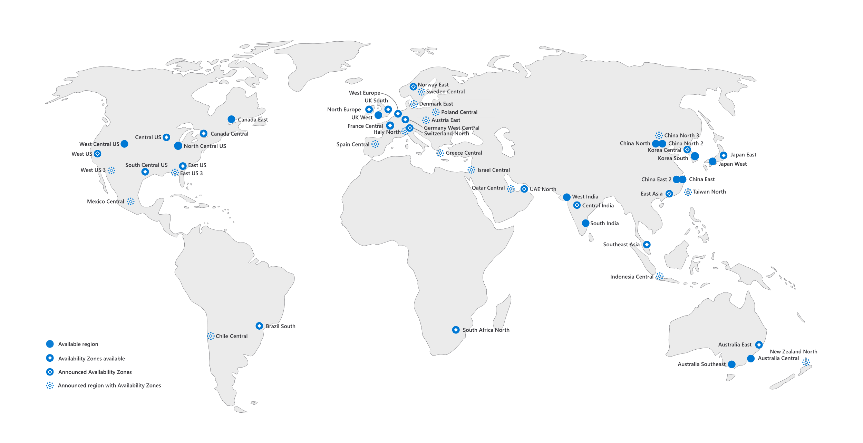
Microsoft global regions

Slide 8
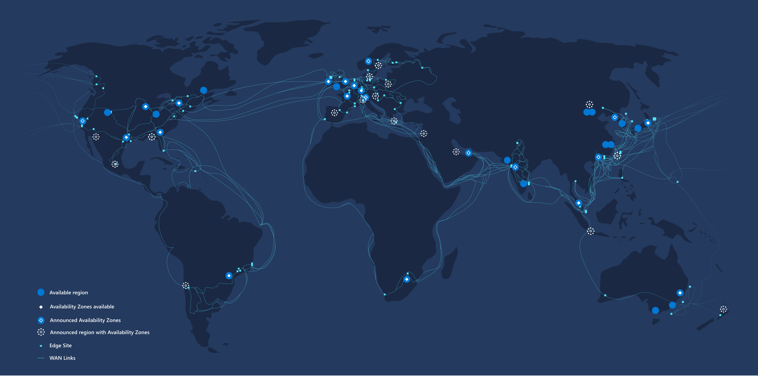
Microsoft global backbone
165k+
miles of fiber + subsea cables
180+
edge sites
500+
network partners
20k+
peering connections

Slide 9
Best performing cloud network
170+ Network POPs placed within 25 milliseconds from 85% of GDP
Once the traffic enters the Microsoft network, it stays on the network by default*
99.05% of Azure inter-region pairs beat the Internet*
*Claims based on the results from the ThousandEyes 2020 "Cloud Benchmark Performance" report. The findings are based on data gathered within and between multiple global regions of the five public cloud providers over a four-week period.
Notes:
First, we strive to be the closest to our customers so that we can absorb their traffic on our global network, off the internet, as soon as possible. Customer traffic enters our global network through strategically placed Network POPs in more than 175 locations and directly interconnected to our internet partners. Today, our Network POPs are less than 25 milliseconds away from 85% of GDP.
Second, once the customer traffic enters Microsoft Global Network, it stays on the network, whereas the other leading cloud provider puts the traffic back to the internet, away from their core network. We use the cold-potato routing technique, whereby the traffic between data centers, within regions or between services are routed within our global network
In fact, as a result, 99% of Azure inter-region latencies beat the internet benchmark, which ensures optimal application performance all the time, compared to the Internet based routing.
Every day, customers around the world connect and pass trillions of requests to Microsoft Azure, Bing, Dynamics 365, Office 365, XBOX, and many others. Regardless of type, customers expect instant reliability and responsiveness from our services.

Slide 10
Zero Trust based network security
All Azure DC-DC traffic encrypted by default
A diverse set of network segmentation controls available to create isolated environments
Private and dedicated connectivity
Intelligent threat protection and secure app delivery
Notes:
In a traditional world, you can secure your corporate perimeters with traditional network controls and keep the bad guys out. However, in a mobile-first, cloud-first work, we see that the rate and the sophistication of security attacks are increasing, and you can no longer rely on the traditional approach.
We have a Zero Trust approach when it comes to security, where you trust no one and assume that there will be a breach. Azure offers multi-layered, built-in security capabilities across the physical network, virtual network, all the way to applications.
To begin with, all traffic between Azure datacenters is encrypted by default, and the traffic stays on our network vs. internet.
You want to be ready with a setup that minimizes the blast radius when there is an incident —this is where segmenting your network while you design its layout becomes important. When you operate on Azure, you have a wide and diverse set of segmentation controls available to help create isolated environments. You can use these five basic controls to perform network segmentation in Azure: Subscription, Virtual Network, Network Security Group, Application Security Group, and Firewall.
Services like Azure ExpressRoute offers dedicated and private connectivity from your on-premises location to Azure to keep you off the internet for maximum security.
Our vast team of data scientists and cybersecurity experts are constantly mining this data to create a high confidence list of known malicious IP addresses and domains. The IP addresses and domains are sourced from the Microsoft Threat Intelligence feed. When you use Azure Firewall, this threat-intelligence based filtering is enabled by default, so that you get intelligent, near real-time security.

Slide 11
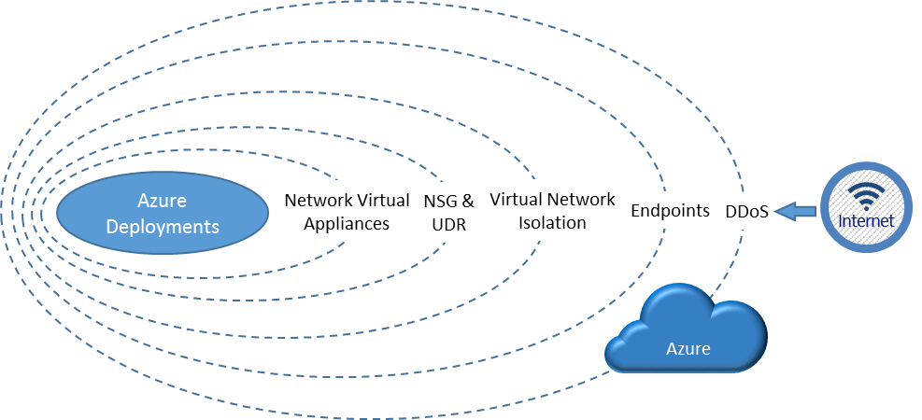
Visualizing layers of security

Slide 12
The Five Pillars of Azure Networking Services

Slide 13
Azure Networking Services
Secure network infrastructure
On-prem and branch connectivity
Remote work at scale
Secure global app delivery
5G and edge computing
Build, protect, and monitor your network infrastructure
Connect on-premises datacenter and branches to the cloud
Enable remote users to access internal resources
Build, secure, and deliver application to serve global user base
Enable edge computing platforms and apps
Notes:
Let’s look at the Azure Networking services available today:
Secure network infrastructure – These services help you get started with Azure. You can build your virtual network infrastructure in cloud, protect it from attacks, monitor and perform diagnostics.
On-prem and branch connectivity – Hybrid is a reality today, and Hybrid connectivity services such as ExpressRoute and VPN Gateway help you connect your on-premises datacenters to cloud. To manage large scale connectivity, for example multiple branches and cloud, Azure Virtual WAN is helpful.
Remote work at scale – A shift to remote work is one of the widespread effects of the global pandemic, and we heard from organizations around the world who are looking for ways to enable more of their employees to work remotely for their safety and that of the community. Azure VPN Gateway helps lets you expand your existing VPN setup to enable employees’ access confidential internal resources.
5G and edge computing – In partnership with carriers, we have laid out Azure Edge Zones to bring life to 5G and LTE enabled edge scenarios.
Secure global app delivery – These services help you deliver and secure applications to serve global user base for example – video streaming or content delivery.

Slide 14
Workshop: Building the Environment

Slide 15
Final Environment
The resources in the blue Resource Group will be built by you today in the workshop
The green box resources won’t be built but will be discussed in this deck

Slide 16
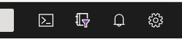
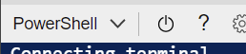
Step 0 – Initialize Cloud Shell
Execution:
Connect to the internet
Login to https://portal.azure.com
Start Cloud Shell (select or create a storage account if prompted)
Ensure Cloud Shell is set to PowerShell
In the cloud shell run Connect-AzAccount -UseDeviceAuthentication and follow the instructions. Login using your Azure Portal credentials
In Cloud Shell run the following to download the workshop files (IWR aka.ms/1).Content | IEX A warning about the subscription ID will be shown, we’ll fix this next
NOTE: The Cloud Shell is where all workshop
PowerShell scripts should be deployed.

Slide 17
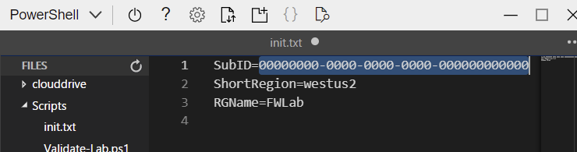
Step 0 (cont) – Update init.txt
All scripts pull critical information from the init.txt file, so it’s important to update this file to reflect the resource group name and subscription you’ll be using for this deployment of the firewall workshop.
Execution:
Open the Cloud Shell editor (red circled icon)
Navigate to init.txt (red boxed item in file hierarchy)
In the right-hand pane, update the Subscription ID to your Subscription ID and optionally the RGName to use the resource group name you wish to use inside your subscription.
Once updated, press CTRL+S to save the init.txt file.
Rerun the validation script, ensuring no errors and that the File Variables are as intended. ./Scripts/Validate-Lab.ps1
NOTE: In the init.txt file there
must be no quotes or spaces

Slide 18
Step 1
Execution:
Change to the Scripts folder cd Scripts
(Optional) in the editor pane you can select and view the script before running
Run step 1 with the following: ./WorkshopStep1.ps1
Validation:
Browse to your Resource Group in the Portal
You should see a Key Vault resource
Explore the Key Vault, and the secrets therein
Take Away:
You now have a Resource Group in Azure to which you can now deploy resources!
NOTE: The Key Vault secrets contain
the Username and Password for
the VMs we will create today!

Slide 19
Secure network infrastructure
Azure Virtual Network
Azure Virtual Network NAT
Azure Private Link
Azure DNS
Azure Firewall
Azure Firewall Manager
Azure DDoS Protection
Azure Bastion
Network Watcher
Azure Monitoring

Slide 20
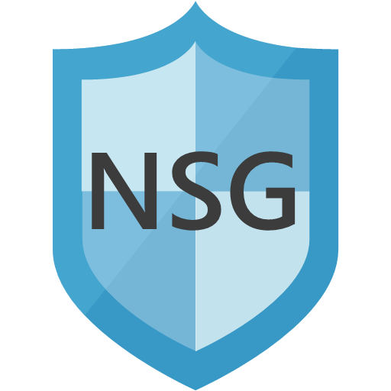
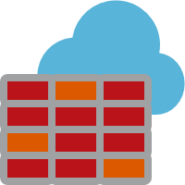

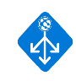

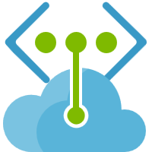

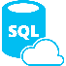
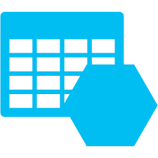
Virtual Networks
Your virtual private network in the cloud
10.1.0.0/16
Private isolated logical network
Supports Network ACLs and IP Management
User defined routing for network virtual appliances
Extends on-premises network to the cloud
Provides secure connectivity to Azure services
UDR
Internet
On-premises
Azure Services
“User Defined Routing (UDR) allows customers to easily secure their lift-n-shift and cloud-native applications in Azure using next-generation firewalls like VM-Series.
This includes micro-segmentation in an Azure VNET and securing Azure applications at scale with VM-Series instances behind the Azure Standard Load Balancer.”
Jigar Shah
Product Line Manager, Palo Alto Networks

Slide 21

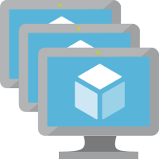

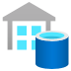
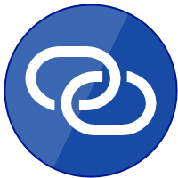


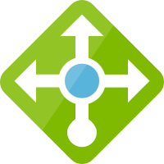
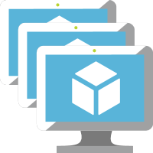
Azure Virtual Network
Customer’s Private Network in The cloud
Azure Private Link
Azure services made available inside customer’s Virtual Network
In-built protection against data exfiltration from the network
Extends to customer’s own services
36 Azure services now available over Private Link
Azure Virtual Network NAT
Fully managed and highly available service for Internet access from Virtual Network
Configurable at subnet level
Built-in auto scale with support for IP prefixes
Easy whitelisting with Static IP Address
10.0.0.5
Azure Services
subnet
Private Endpoint
Azure Private Link
Azure PaaS
Your Own Service
Internet
subnet
subnet
NAT gateway
Notes:
VNet – Private, Isolated, Secure Network
VNet Extended to PaaS services. Secure the network, Secure the PaaS resource. Increase the abilities but still keep it all private.
Private Link extends to customer’s own service as well.
36 Services.
Azure NAT: Fully managed, Cloud native, scalable solution to Internet
No worries abt SNAT port exhaustion
Private subnets connected to Internet.
GA and available in all regions.

Slide 22
Step 2
Execution:
In the Scripts folder run ./WorkshopStep2.ps1
(Optional) in the editor pane you can select and view the script before running
Validation:
Browse to your VNet in the Portal
Review the subnets
You should see three subnets
Take Away:
You now have a network in Azure to which you can now deploy resources!
NOTE: You may see “warnings” from PowerShell about upcoming changes. These warnings do not affect running of the scripts.
Notes:
Although the VNet is referred to as a “Hub”, it is no different than any other VNet, “Hub” is just a distinction for how we intend to use the VNet later.

Slide 23
Step 3
Execution:
In the Scripts folder run ./WorkshopStep3.ps1
(Optional) in the editor pane you can select and view the script before running
Validation:
Review the VM components
(optional) RDP to the VM’s Public IP using the User01 password from the Key Vault secret
Take Away:
You now know how to deploy a simple, publicly accessible VM into a VNet in Azure.
Notes:
Jump VM refers to how we intent to use the VM, Jump server – Wikipedia. While we won’t use this as an actual Jump VM today, we will show how connectivity is cut off from the Internet once the Firewall is deployed.

Slide 24
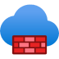


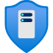

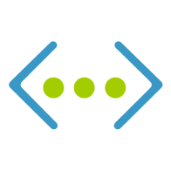


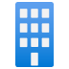
Azure Firewall, DDoS
Internet
Azure Firewall
Cloud native network security to protect networks, and resources
Central governance of all traffic flows
SQL filtering, IP Groups, Auto SNAT, Forced Tunneling
DNS proxy, custom DNS, FQDN filtering in network rules (all ports/protocols)
Spoke VNET
Central VNET
Spoke VNET
DDoS Protection Standard
Adaptive Tuning
Engine
Adaptive Tuning
Engine
Inbound /
Outbound
Inbound
Azure DDoS
Web
Application
Azure DDoS
Cloud scale DDoS protection for Azure resources
Global shared mitigation capacity increased to 45 Tbps
Web
Application
Azure Firewall
Azure WAF
Web
Application
On-premises

Slide 25


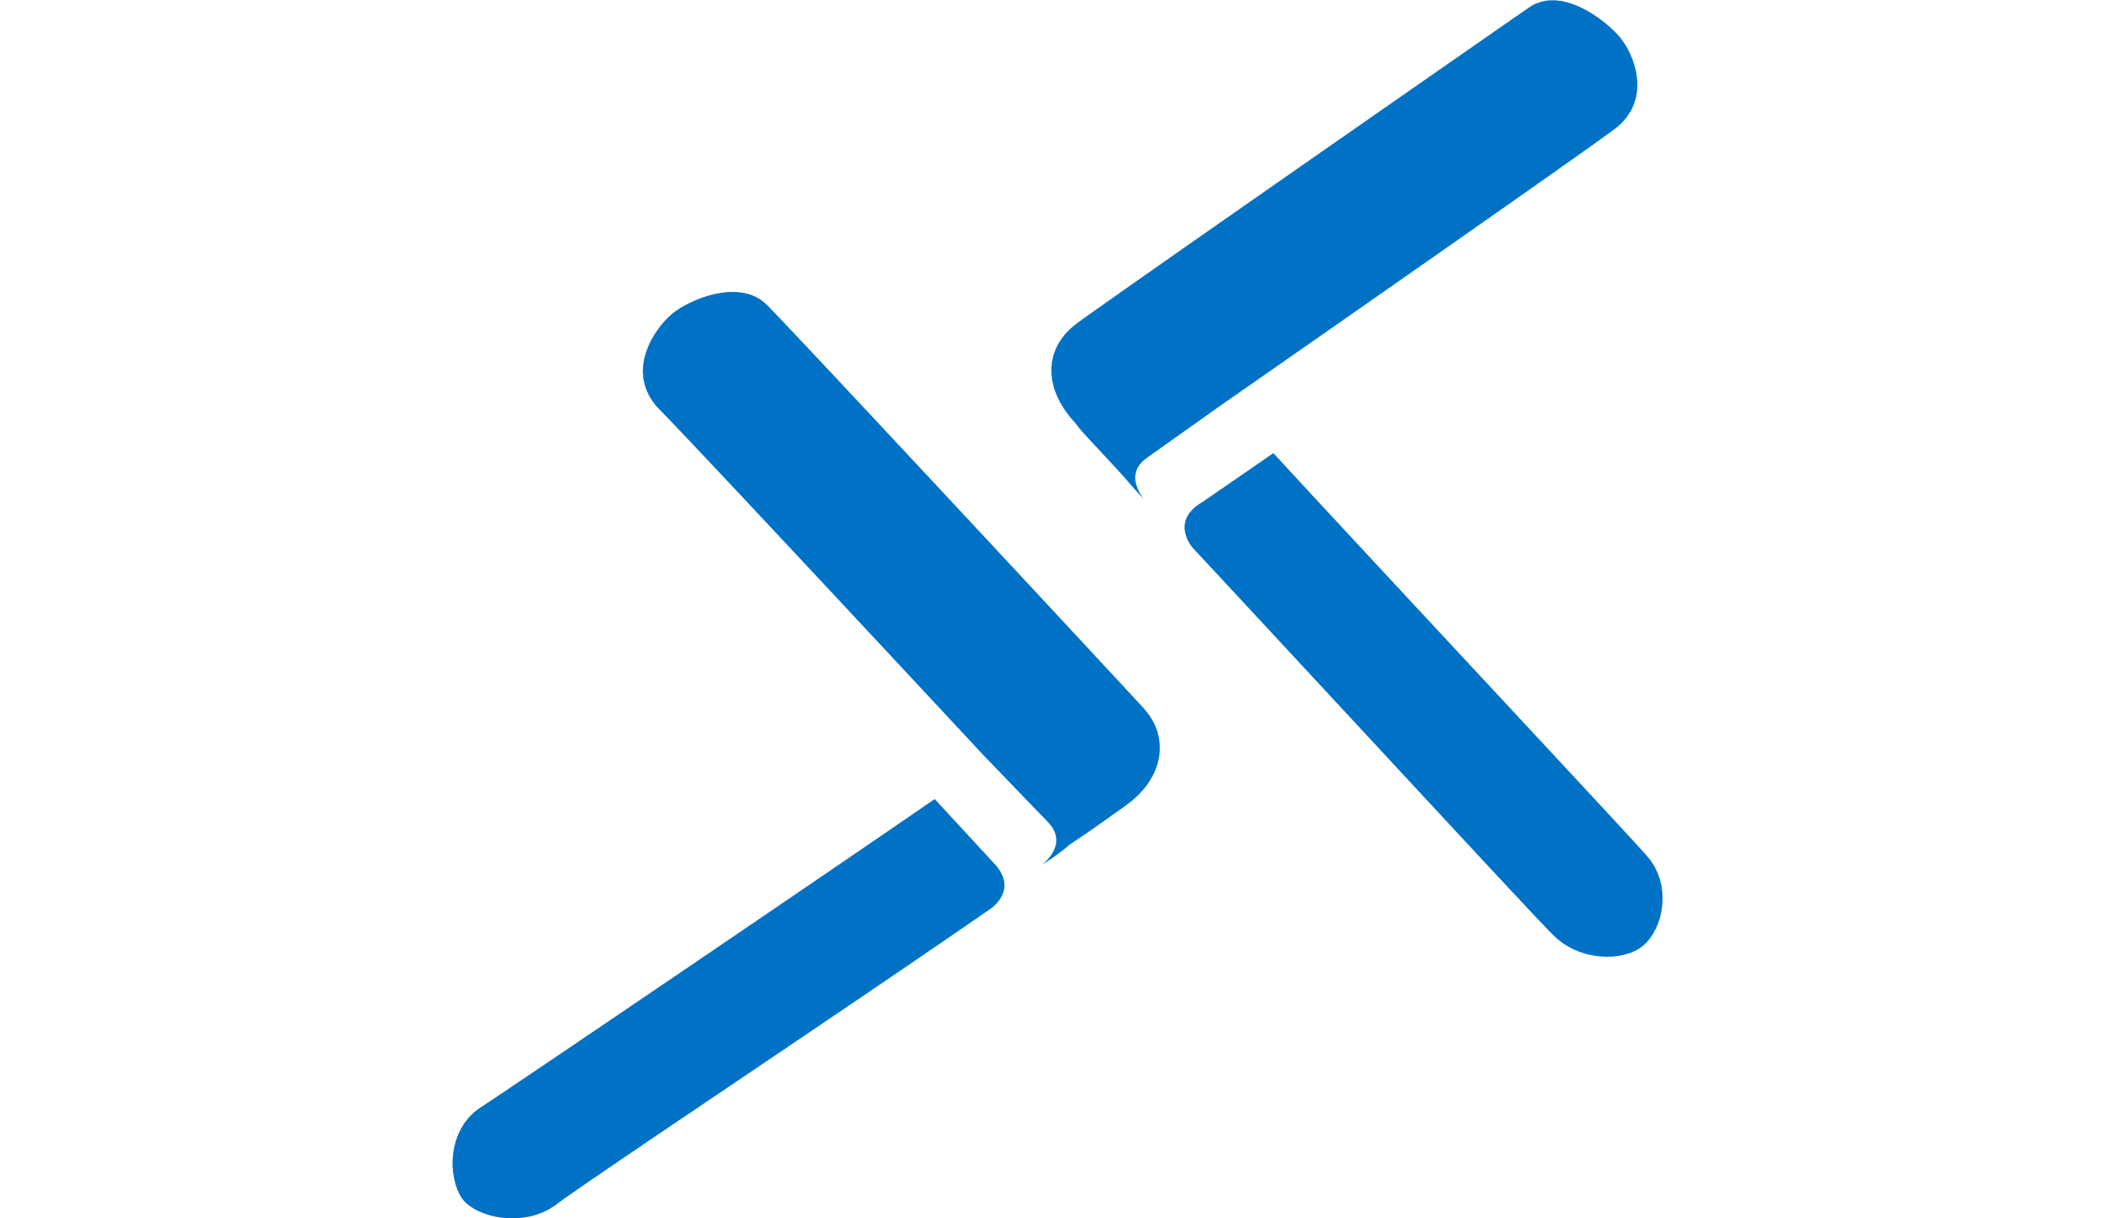
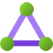

Azure Bastion
me
Secure and seamless RDP and SSH access to your virtual machines without public IP address
TLS
Azure Portal
TLS
Access to Azure VMs in peered VNet in same subscription
Access to on-premises VMs via VM’s IP address or DNS hostname
Azure Bastion
Feature announcements
Azure Key Vault Integration (GA)
RDP/SSH access to AKS nodes (GA)
Bastion Health metrics (Public preview)
Session | CPU | Memory
Bastion Scalable Gateway (Coming mid 2021)
Support as many as 500 concurrent sessions
Ability to decrease the gateway size
Azure VM
Azure VM
ExpressRoute
VNet Peering
On-prem VM
On-prem VM
Azure VM
Azure VM
Notes:
Bastion popular service for secure RDP/SSH connectivity.
On-prem VMs.
Peered Vnets. Cost effective.

Slide 26
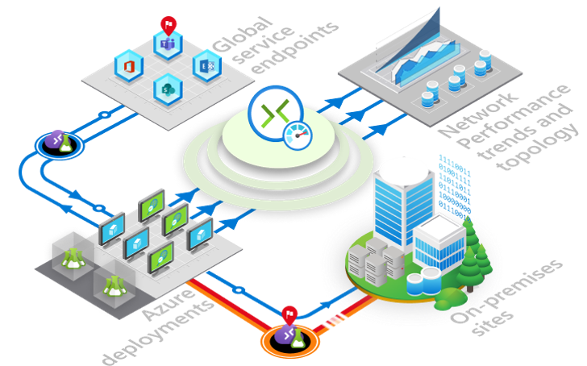
Monitoring
Simplified and centralized network monitoring
Azure Monitor for Networks
Single health, metric, alert and diagnostic console for all network resources across your subscriptions
On by default
Connectivity, traffic and diagnostic features seamlessly integrated
Connection Monitor
Monitor endpoints within and across Azure regions, on-prem sites and global service locations
Visualize end-to-end network topology, loss and latency across on-prem and Azure locations
Mitigate connectivity issues faster with metric-based alerts and built-in diagnostics
Notes:
Add Talking points
Azure Monitor for Networks is the Networks insights part of Azure Monitor. It provides a comprehensive view of health and metrics for all deployed network resources in your subscriptions. It is on by default and requires no user configuration. If you are running active connection monitoring or Azure traffic analytics, these results will also be available via Azure Monitor for Networks. In addition, custom monitoring and diagnostic experiences are now available for App GW, SLB, vWAN and ER, and other Azure Net services are being onboarded to Azure Monitor for Networks.
Active connectivity monitoring remains of great interest to customers. We have had two separate and sometimes overlapping solutions for this – NPM for hybrid environments and Network Watcher for monitoring within Azure. Connection Monitor is our single, unified connectivity and network performance monitoring solution that works from both on-prem and from within Azure to monitor endpoints anywhere. Connection Monitor provides better experience, fast metric-based alerting and diagnostic enhancements compared to the previous solutions. We have added significant capabilities to the public preview, including ER and bi-directional perf monitoring.
Note – Both of these are scheduled for GA in October.
General one line of text

Slide 27
Step 4
Execution:
In the Scripts folder run ./WorkshopStep4.ps1
(Optional) in the editor pane you can select and view the script before running
Validation:
In the portal, pull up the Firewall
Review the properties, especially the Rules section.
Try RDPing to your Azure VMs public IP, because we don’t have a rule for that, it will fail.
Take Away:
You just protected your resources from the Internet.

Slide 28
Step 5
NOTE: When browsing today
be sure to use HTTP,
not https. I’m too
lazy to create certs.
☺
Execution:
In the Scripts folder run ./WorkshopStep5.ps1
(Optional) in the editor pane you can select and view the script before running
Validation:
In the portal, pull up the Firewall
Review the Rules section.
From a browser hit the public IP of the firewall (it will NAT to the IIS server and provide a web page)
(optional challenge) Add a Firewall rule to allow RDP to the Jump box. Then RDP to the Jump VM and hit the private IP of the IIS server (the firewall network rules should allow the page to be visible)
Take Away:
You just deployed your company’s first web site!

Slide 29
On-prem and branch connectivity
Azure ExpressRoute
Azure VPN Gateway
Azure Virtual WAN
Azure Route Server
Azure Peering Service
Azure routing preference
Azure Orbital

Slide 30



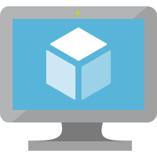
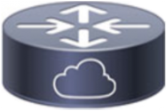
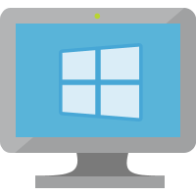
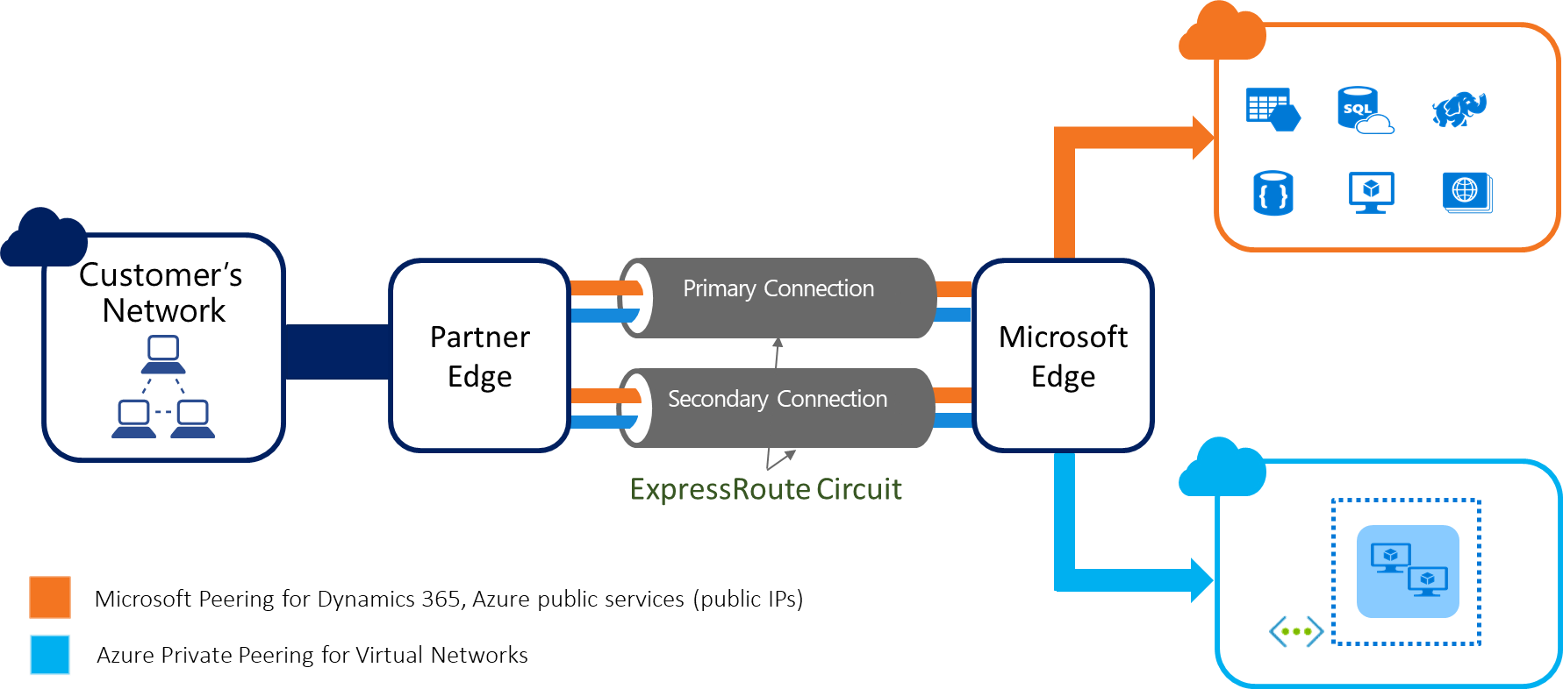
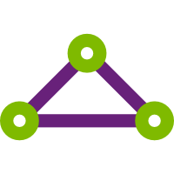
ExpressRoute
On-Premises
Private connectivity to Microsoft
IPv6 NSG Rules
Application Subnet
Front-End Subnet
IPv6
ER Gateway metrics: packets per second and CPU utilization, with native alerting via Azure Monitor
Support for up to 16 circuits per Gateway
IPv6 User-Defined Routes
Linux VM
IPv4
IPv6
IPv4
Load Balancer
Windows VM
ExpressRoute
IPv6 Private Peering
Internet
IPv6
IPv6
Notes:
New Features (March 2021)
IPv6 Private Peering (requires AZ GW sku)
1000 max prefix from Azure to on prem (increased from 200) (GA)
New gateway metrics: (GA) CPU, PPS, # of route advertised and received, Frequency of route changes, # of VMs in a VNET
MACsec SCI and new Cipher support (Coming Soon) for ER Direct

Slide 31
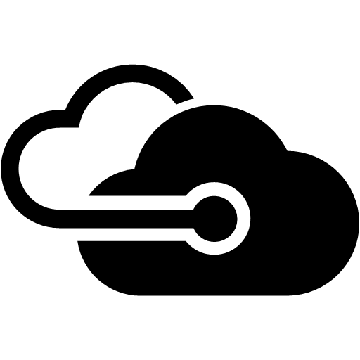
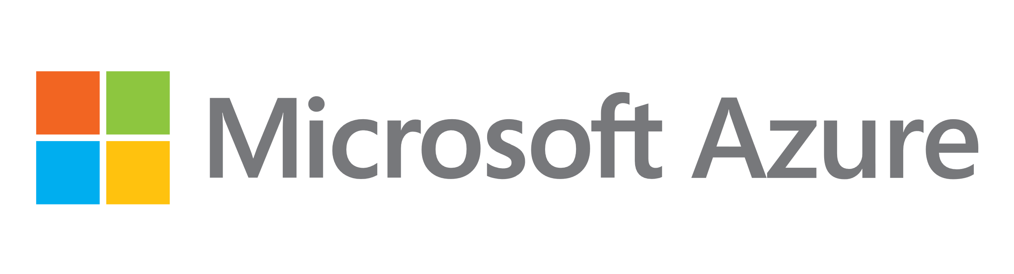
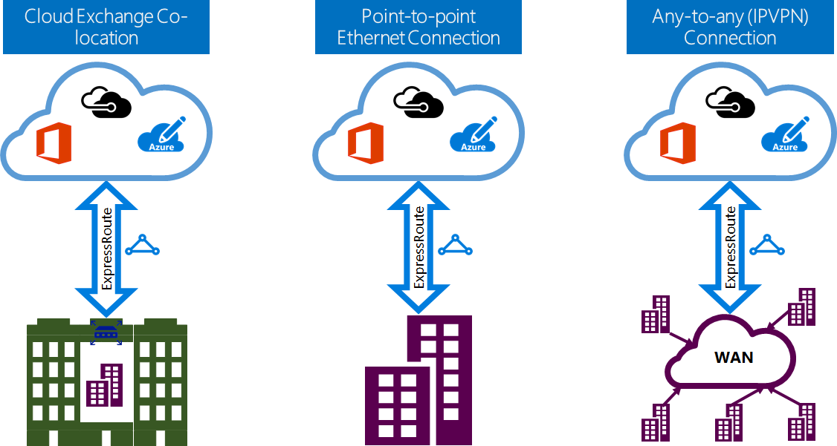
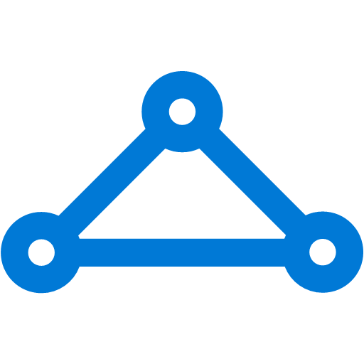
ExpressRoute Connectivity Models
ExpressRoute Direct
MSEE1
MSEE2
10Gbps /
100Gbps
10Gbps /
100Gbps
Customer’s
Edge routers
ExpressRoute partner hands off a LAYER 2 service to the end customer
ExpressRoute partner hands off a LAYER 3 service to the end customer
ExpressRoute Peering Location
Service Provider Model

Slide 32






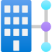
Azure Virtual WAN
Unified and ubiquitous connectivity, routing and security
Transit connectivity
VPN <-> Remote Users
VPN <-> ExpressRoute
VNET <-> VNET
Customized Routing
Security with Azure Firewall and Firewall Manager
Corp HQ
VNet
VNet
VNet
ExpressRoute
VNet
Region 2
Datacenter
User VPN
(Point-to-site)
Region 1
Region 3
Internet
Branch
Branch
Branch
Branch
Notes:
Virtual WAN provides a unified framework for connectivity , security and routing. Deployed in hub and spoke based architecture it can be used to accelerate, scale, or re-architect a network.
Hub to Hub
Custom Routing
FW Manager GA – customize or set policies on sec SaaS
50 Gbps transit for VNet to VNet
Talking points
Very pleased to announce Cisco to the new set of NVA partners that can be deployed inside a virtual WAN hub. With Azure native advantages of built-in resiliency, customized routing provided by the virtual wan router and integrated with Azure firewall in vwan, users looking for a no hassle SASE can now avail these services in Azure.
Custom Routing available since August 2020.

Slide 33
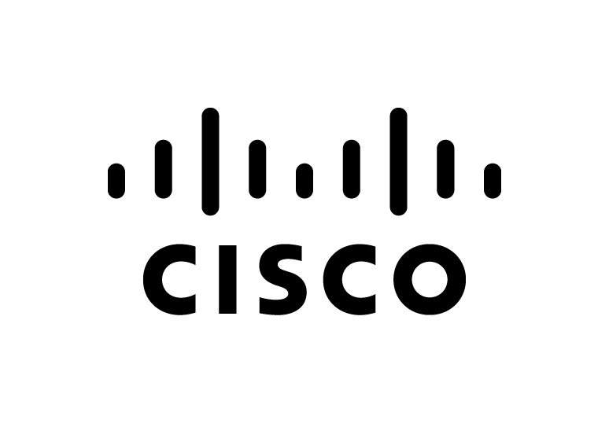
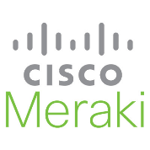
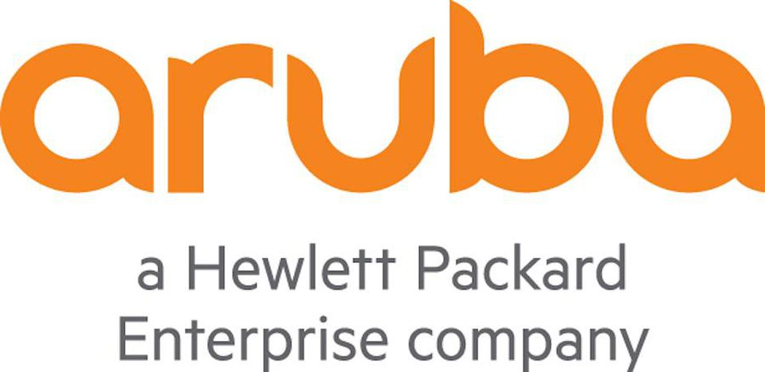

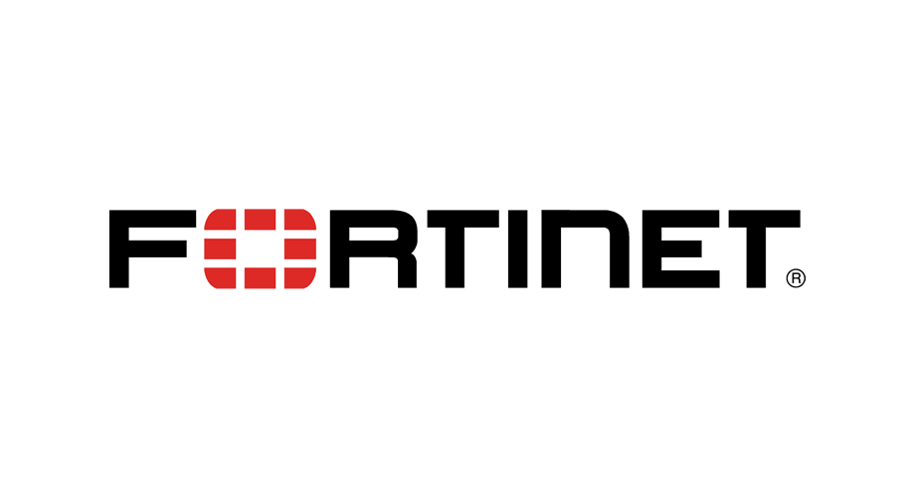
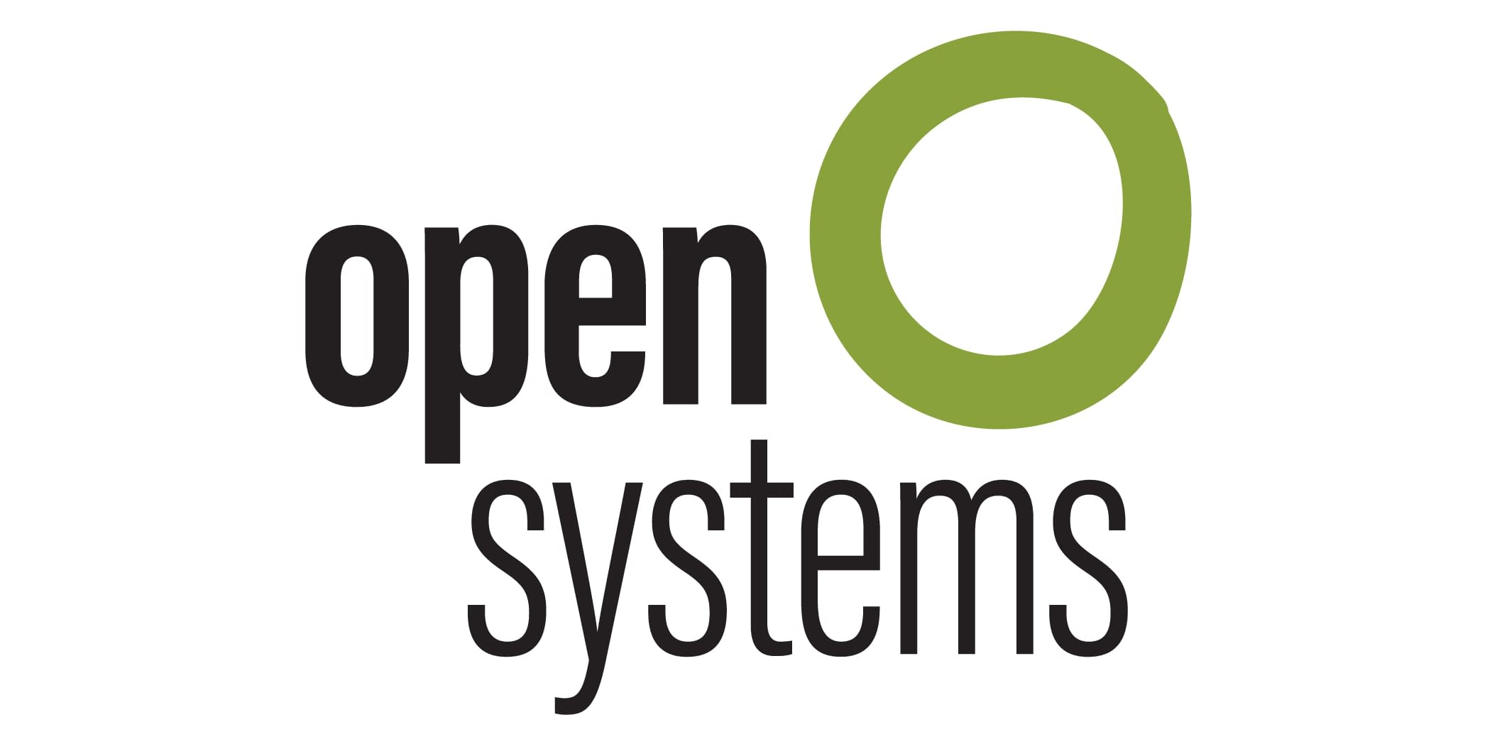
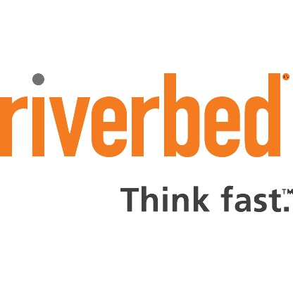
Virtual WAN Ecosystem
Announcing: Virtual Appliances in the VWAN hub
SD-WAN
VPN & Remote work connectivity
Notes:
Talking points :
3 partners sections
VPN/SDWAN device ecosystem – automation for branch connectivity, such as Ipsec straight into Azure and our global network.
Newest enhancement now allows for deploying and running a network virtual appliance such as SD-WAN directly inside the the vWAN hub. We announced this at MS Inspire in July with Barracuda as first partner to support this new capability.
I’m super excited to announce that Cisco Viptela SD-WAN is now also supported in preview
Growing number of Telcos and SIs are now offering Managed Services for Virtual WAN​ and Azure networking services, here is a list of partners that provide end to end planning, Design, Implementation and Operations of Enterprise Hybrid Networks based on Virtual WAN ​

Slide 34

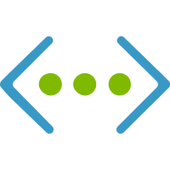
Azure Route Server
On-prem 1
Internet
Provide BGP* endpoints for network virtual appliance to connect
Enable dynamic routing between NVA and Azure virtual network
Simplify NVA deployment on Azure
Support any NVA**
Network topology agnostic (e.g., single VNet, hub-and-spoke, full-mesh)
Integrated with ExpressRoute and VPN gateway
* Border Gateway Protocol is a standard routing protocol
** NVA must support multi-hop BGP
10.250.0.0/16
SDWAN
FW
0.0.0.0.0/0
10.1.0.0/16
10.0.0.0/8
BGP
BGP
10.1.0.0/16
10.250.0.0/16
ARS
Azure Route Server subnet
App VM effective routes
Route Next hop
10.250.0.0/16 SDWAN
10.1.0.0/16 Virtual Network
0.0.0.0/0 FW
App subnet
10.1.0.0/16

Slide 35
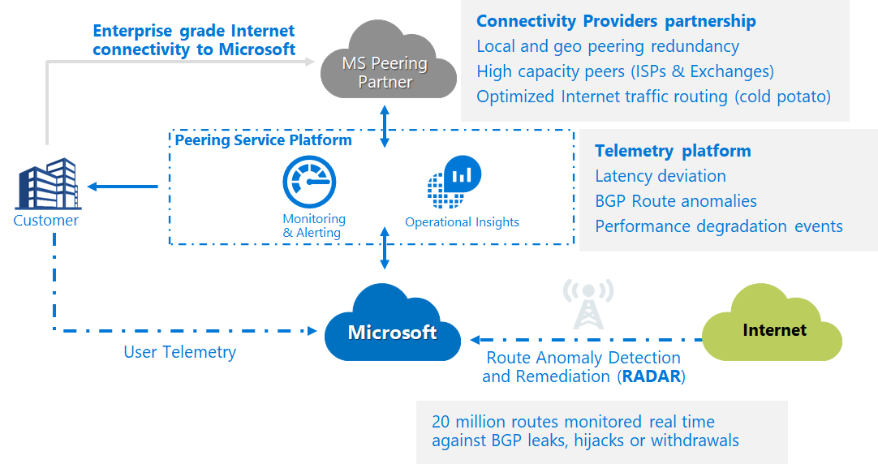
Azure Peering Service
Delivering enterprise grade internet connectivity to Microsoft Cloud Services
Optimized Routing
High Capacity ISPs/Exchange partners
QoS for voice/video
Local and Geo redundancy
Cold Potato routing – guaranteed one hop from Microsoft
Performance Insights
End to end latency deviation
Connection Monitor integration
Monitoring & Alerting
Route Protection
Route Anomaly Protection with RADAR (Route Anomaly Detection & Remediation)
Millions of routes monitored for BGP hijacks, leaks, & withdrawals.
Route Signing with RPKI

Slide 36
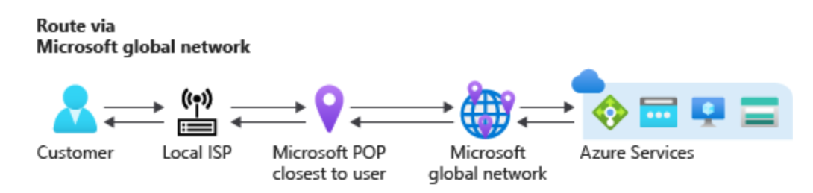
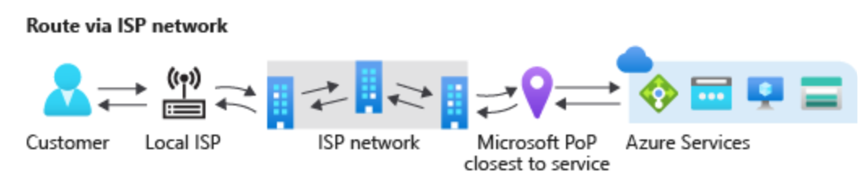
Routing Preference
Enables network choices for internet bound traffic
PREVIEW
 | Routing via Microsoft Network | Routing via ISP Network
Routing | Traffic rides on premium Microsoft network for bulk of its journey | routed via ISP network (public internet)
Performance | Premium performance, high reliability | ISP network performance & reliability
Use case | high network reliability global customer base | egress cost optimization regional customer base
Notes:
Microsoft global network is a premium network with 160,000 fiber miles and 165 edge pops around the world. Provides best networking performance
New cost optimized option is suitable for workload that do not require a private backbone network and is good with ISP network. AWS routes internet bound traffic using ISP network. Azure pricing is cheaper than AWS but performance is comparable with AWS. Google has this product already called “Network service tier”
3. Customer can enable this though public ip, which then can be associated with internet facing resources such as VM, VMSS, internet facing LB, app gateway etc. Also, customer can set this for Storage account and Azure data lake

Slide 37
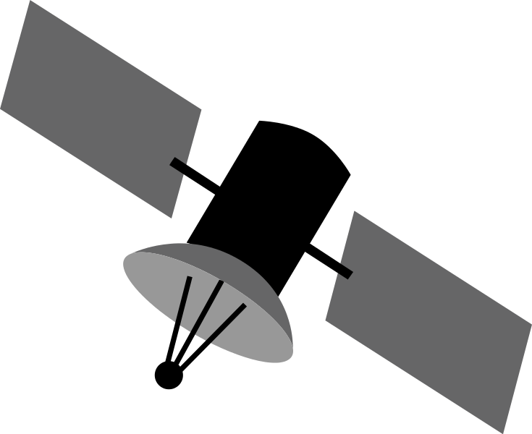
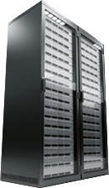
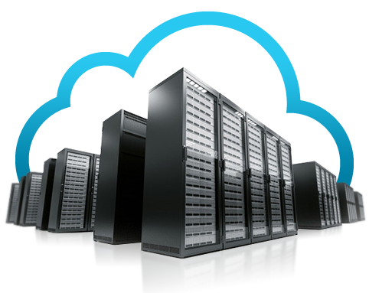




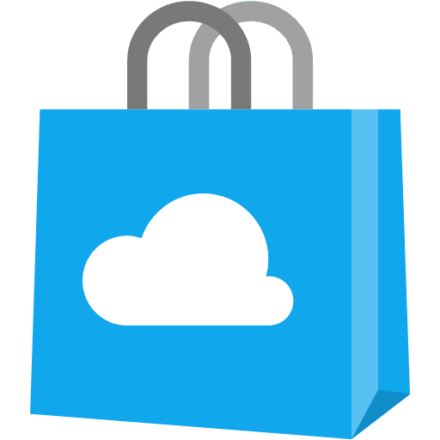


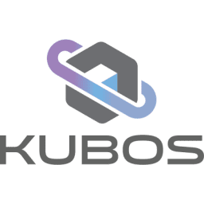

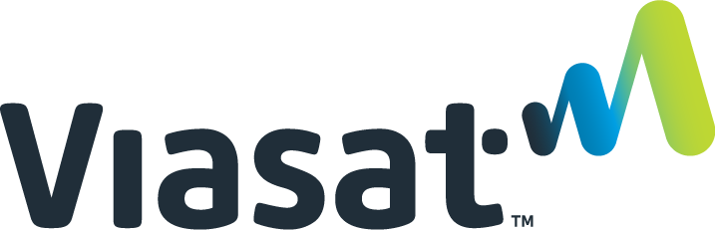


Azure Orbital
Ground Station as a Service
Orbital Services
Azure Services
ExpressRoute
Firewall
Edges & regions
Virtual network in Azure
Firewall Manager
Virtual WAN
Provider’s Virtual
Network
On-premises
Internet
3P Marketplace
DDoS
Orbital Ground Station
(Provider or
Customer-dedicated)
Notes:
With Azure Orbital, Satellite providers can co-locate ground stations with Azure datacenters or in close-proximity to the edge of our network. They can also inter-connect their existing ground stations with our backbone network. This enables them to leverage global Azure backbone network to augment their ground network capacity.
Azure Orbital services delivers the traffic from Orbital ground station to Provider’s virtual network. Using these Azure Orbital services, a satellite provider can integrate or bundle other Azure services (like Security services like Firewall, connectivity services like SDWAN, etc.) alongwith their satellite connectivity to provide managed services to their customers in addition to satellite connectivity.
While doing so, satellite providers can decide to deliver traffic and managed services to customer’s on-premise network, or customer’s virtual network in Azure, or transit to provider’s network edge in another region using Azure global backbone network, or leverage breakout at the edge of our network to provide internet services to their customers.

Slide 38
VPN & Remote work connectivity
Azure VPN Gateway

Slide 39


VPN
Azure region
S2S – cross-premises connectivity
VPN over ExpressRoute private peering
IPsec encrypted ExpressRoute
FQDN S2S
Customers without static public IP addresses
BGP with APIPA addresses
Legacy device, AWS/GCP interop
P2S – user SSL VPN connectivity
COVID-19 remote VPN usage surge
94% increase in daily P2S connections
P2S session management & revocation
List & disconnect user connections
Spoke
Hub
Spoke
ExressRoute
Az VPN
Microsoft
backbone
ExR edge
Internet edge
Customer
WAN
Internet
Customer VPN
ExpressRoute
Private Peering
Site to site
VPN
Point to site
VPN

Slide 40
Step 5 (cont)
Execution:
Turn on and review monitoring
In the portal open the firewall
Click the “Diagnostic settings” tab
Click the “Turn on diagnostic” link
Name your setting “Firewall-Logs”
Check “Send to Log Analytics”
Select your Company’s workspace
Check both log types and save
Validation:
In your Resource Group open your “Log Analytics workspace”
Open the “Logs” tab
Review the slide notes below to see some example queries
NOTE: It may take up to 10
minutes for logs to
begin flowing into
the log workspace.

Slide 41
UDR
Notes:
The simplest UDR rule is the UDR table for the Tenant subnets. 0.0.0.0/0 to the firewall and stop BGP propagation.
0.0.0.0/0 this is the most generic IP rule, saying if nothing more specific is found in the local route table for the NIC, this is the route "of last resort".
If BGP is allowed to flow to the subnet, you'll have more specific rules in the route table, then the 0.0.0.0/0 rule wouldn't be used. Turning of BGP ensures no other routes become "local" and the traffic is always sent to the firewall.
On the gateway subnet, the rules aren't that simple. If this environment had VPN or ExpressRoute enabled, this subnet would need to be the gateway to other networks. If we used the 0.0.0.0 rule here, the VPN Gateway would form a routing loop with the firewall, never sending anything to on-premises because the 0.0.0.0 rules says *always* send to the firewall. So the rule for the gateway subnet has to be tailored for your cloud network. There are two address prefixes (10.11.12.0/25 and 10.11.12.128/25), basically saying anything coming into this subnet going to a cloud resource should be sent to the firewall for evaluation first, however anything heading to on-prem (an address that doesn't match any addresses in the UDR table) would be allowed to travel normally. For our lab, all traffic come to the gateway subnet should be coming from the firewall as the 0.0.0.0 rule on the other subnets would never send traffic directly to the gateway subnet.
On the Firewall subnet, you'll see there are no UDRs. The firewall holds the policy for the entire network, and needs access to all subnets and so we don't apply any special routing for our deployment today.

Slide 42
Final
Review these additional features in this deck:
Virtual WAN
Load Balancing Overview
Global: Azure Front Door
Global: Traffic Manager
Regional: Application Gateway
Regional/Local: Azure Load Balancers
Azure DNS

Slide 43
Secure global app delivery
Azure Load Balancer
Azure CDN
Azure Front Door
Azure Web Application Firewall
Azure Application Gateway
Azure Traffic Manager
Internet Analyzer

Slide 44



Azure’s load balancing options
Load Balancer
Application Gateway
Traffic Manager
Front Door
Network Layer (TCP/UDP)
Extreme perf sensitive
Ultra-low latency
Application Layer (HTTP/HTTPS)
TLS/cert based auth
DNS-based load balancing
Variety of routing options
Application Layer(HTTP/HTTPS)
Load balancing at the edge
Notes:
Recent Updates:
Cross-region support (on the next slide)
SKU upgrade while retaining Public IP, Basic to Standard | IP preservation
IP based backends
Resource group moves
Load Balancer insights in Azure Monitor

Slide 45










Load balancing in Azure
Preview
Application Gateway
Application Gateway
Front Door
Traffic Manager
Load Balancer
(Public)
Load Balancer (Internal)
Global
Region / Zone
Global
Regional
Internal
Route to your closest available service region or your on-prem DC. Offload SSL, improve performance / accelerate websites at the Edge.
Route across zones and into your VNET. Offload SSL and build your application-specific logic.
Route across and between your resources to build your regional application.

Slide 46

Azure Load Balancer
Build highly performant, ultra-low latent, global, applications in Azure
PUBLIC PREVIEW
Cross-region load balancing
Scales across regions behind a single anycast IP address
Preserves Client’s source IP Address
Optimized latency-based routing with seamless failover
Easy to adopt – works with existing regional load balancer
New!

Slide 47



Application Gateway
Application/Layer 7 load balancer
HTTP/HTTPS applications
WebSocket and HTTP/2 support
TLS termination
Terminates connections
Source IP is changed
Auto scaling support
Availability zones support
HTTP to HTTPS redirects
GoLowWaste.com
172.168.37.31
Routing
Regional
Across Availability Zones
Content based
Incoming URL attributes
Host/domain name based
Cookie based session affinity
/images/*
/video/*

Slide 48
Traffic Manager
DNS-based load balancer
Supports external, non-Azure endpoints
Hybrid cloud and on-premises deployments
Public facing endpoint
Routing methods
Priority, weighted, performance, geography, subnet, multi-value

Slide 49






Delivery services (AFD, CDN, Application Gateway) Scalable and secure entry point for your global applications
Cloud native, platform managed global and regional application delivery with integrated WAF and Bot protection
Azure Region
What’s New
App Service
API Mgmt
Cloud Service
Rules Engine for AFD/CDN
Wildcard domains for AFD
WAF Sentinel Integration
dynamic
Azure Front Door
PaaS
Azure Region
Microsoft Backbone
static
Public Preview
Per URI WAF policy
Multi Origin support for CDN
AKS Ingress Controller add-on support for Application Gateway
URL rewrite support for Application Gateway
Wildcard listener support for Application Gateway
IaaS
Azure CDN
Edge locations
On-Premises
Notes:
WAF
Sentinel integration: with built-in WAF connector and workbook templates, customer can easily integrate WAF logs to Azure Sentinel, centralize security event managements
Per URI based WAF policy offers granular policy control, for example, customer may define a different WAF policy for /login vs /images
Rules engine for AFD/CDN:
Rules engine allows users to control various attributes of incoming requests or outgoing responses (like headers, cookies, attributes, caching etc) based on a conditional matching criteria. This flexibility allows users to perform operations like injecting HSTS security headers, or routing users to different backend pools based on headers/cookies/querystring parameters
Wildcard domains for AFD:
Having wildcard domains in your Azure Front Door configuration simplifies traffic routing behavior for multiple subdomains for an API, application, or website from the same routing rule. You don't need to modify the configuration to add or specify each subdomain separately. As an example, you can define the routing for customer1.contoso.com, customer2.contoso.com, and customerN.contoso.com by using the same routing rule and adding the wildcard domain *.contoso.com.
Multi Origin support: Multi Origin support provides better resiliency to global workloads. Azure CDN probes health of each origin and automatically fails over if an unhealthy origin is detected. This feature is available in public preview on Azure CDN from Microsoft.
AKS Ingress Controller add-on support for Application Gateway:
Application Gateway Ingress Controller eliminates the need to have another load balancer/public IP in front of your AKS cluster, which avoids multiple hops in your datapath before requests reach the AKS cluster. As a result it delivers higher performance comparing to the traditional ingress controller. We recently launched the preview of an AKS add-on feature to further simplify the Ingress Controller deployment. Users can now deploy the AKS cluster, Ingress Controller add-on, and the Application Gateway all in one line through Azure CLI
URL rewrite:
URL rewrite allows you to rewrite the hostname, path, and query string within the request URL. You can choose to rewrite the URL of all requests or only the ones which match a user-defined condition. When routing a request to the backend, you can route based on either the original URL or the rewritten URL.
Wildcard listener:
Similar to the wildcard domains capability in the AFD, we are bringing the capability to Application Gateway. And it is currently in preview. You can now use wildcard characters, such as asterisks (*) or question marks (?), in the hostname of listeners on the Application Gateway. You can configure up to 5 hostnames per multi-site listener (wildcard/non-wildcard).

Slide 50
What we did today!
Business Problems Solved:
Contoso’s branch office Ops Personnel are connected to their Azure deployments.
Contoso has a web site in Azure that is secure in a current architecture.
You should now be better able to…
discuss Azure Networking options in general
describe how virtual networks can be used, including VNet Peering
describe connectivity options from on-premises to Azure
know how to implement and configure Azure Firewall
understand and describe the three rule types associated with Azure Firewall
understand how to monitor and track events on the Azure Firewall

